Slide 1

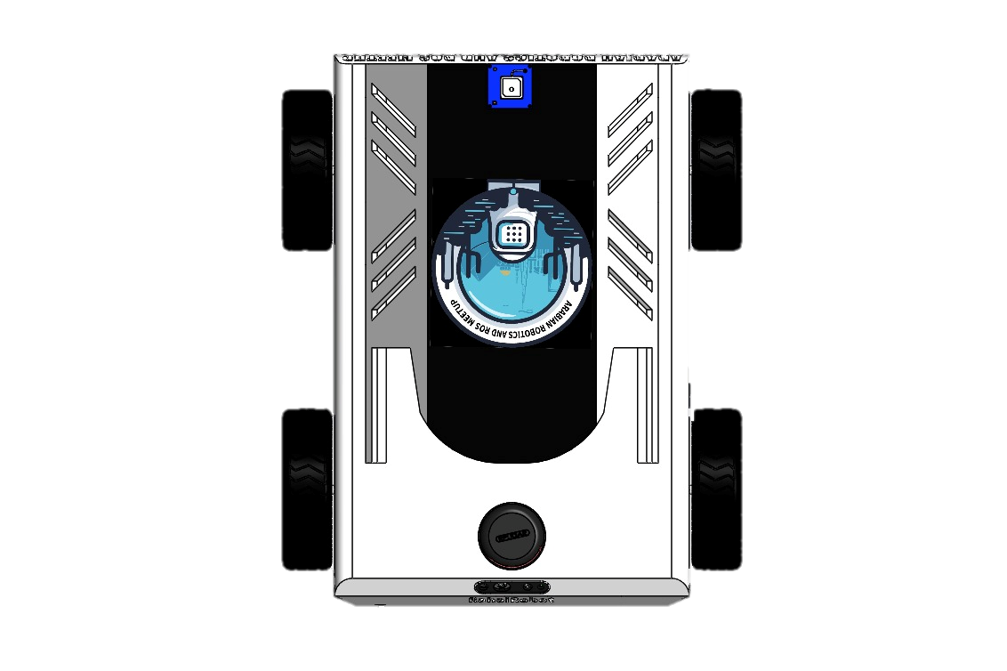
Ideal Situation

Slide 12

After covering the environment

